Slide 1
JAYPEE UNIVERSITY OF ENGINEERING & TECHNOLOGY,
GUNA
Department of computerscience & engineering
Project No. - 15
ONLINE AUCTION AND RENTING SYSTEM
Submitted by:
Ajay Kumar(161B015)
Shikhar Tiwari(161B213)
Vineet Singh(161B268)
Under Supervision of:
Mr. Amit Kelotra

Slide 2
INTRODUCTION
Online auction system is an online auction home so the seller or buyer doesn’t need to go anywhere, they can take part in the auction just sitting in the comfort of their room.
This site also acts as an open platform where buyers and seller can come together and exchange their items.
Every person can sell or buy any goods without meeting people personally. Seller can get the best possible price which is greater than his target.

Slide 3
Functionalities
Person
He’ll be able to login, register, logout
Seller
He’ll be able to sell, register and accept goods
Buyer
He’ll be able to buy and see the auction details
Here buyer and seller are sub classes of person.

Slide 4
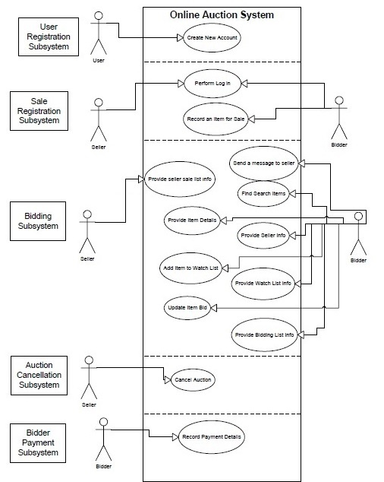
Use Case diagram

Slide 5
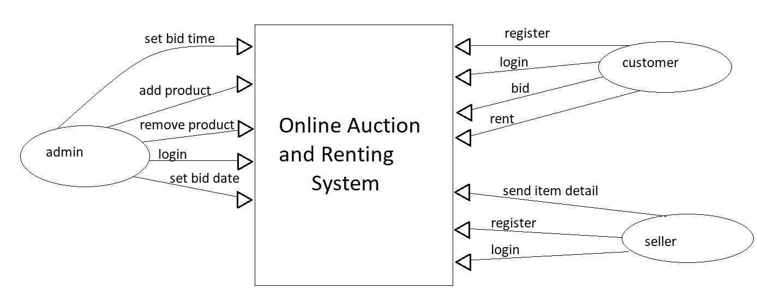
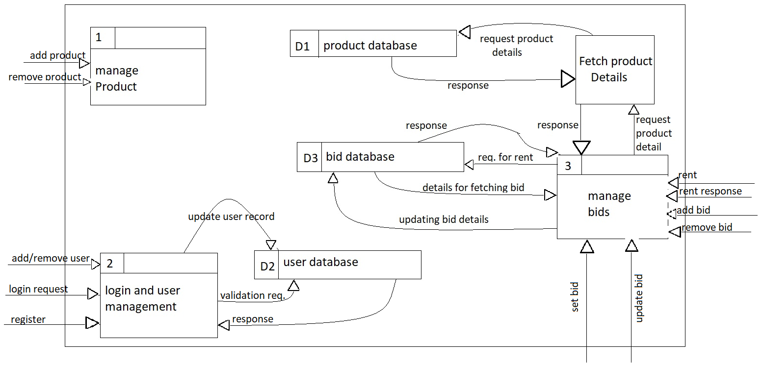
Data Flow Diagram
Level 0
Level 1

Slide 6
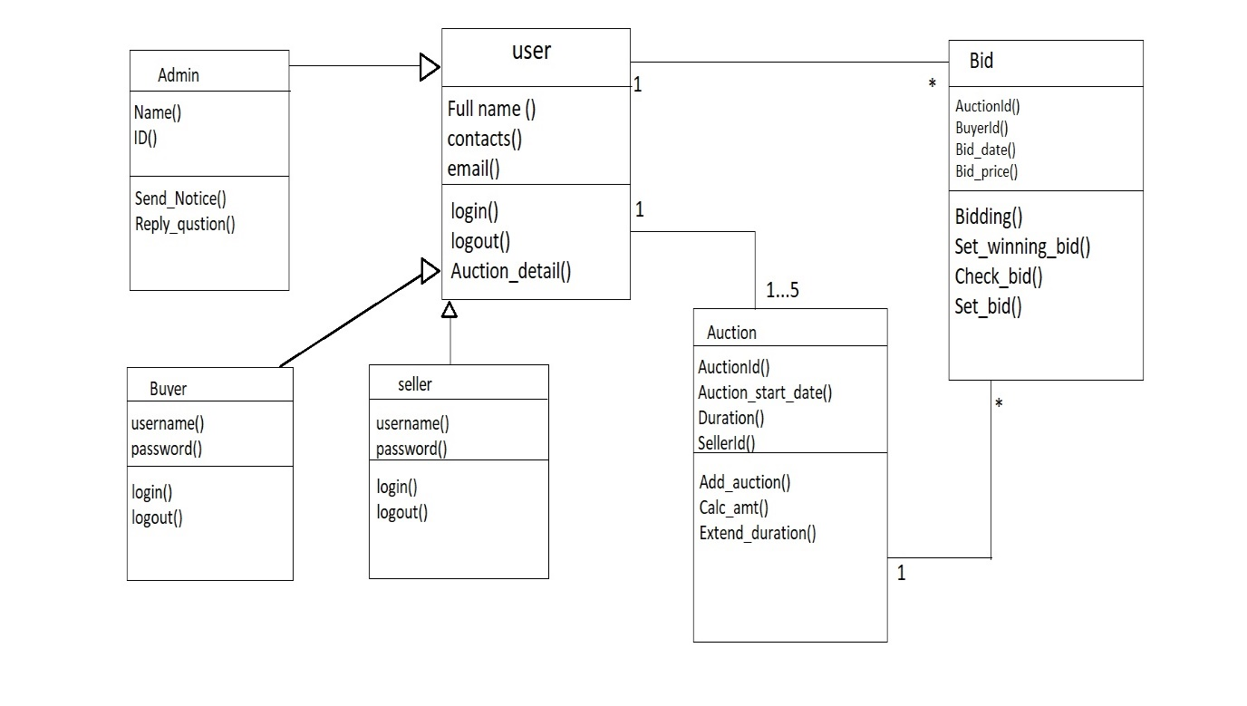
Class Diagram

Slide 7
Seller
Seller can upload auction product.
Seller can set the starting prize of the item.
Seller can view the bid information for their items.
Seller can bid for product.
Buyer
Buyer can buy package for auction.
Buyer can view detail of product.
Buyer can bid on particular product.
Buyer can also modify the bidding prize.

Slide 8
Technology stack
Front-end technologies:
Core technologies :
HTML
CSS3
JavaScript
jquery
Libraries used:
Bootstrapv4.1.3
Backend Technologies
Nodejs
Google firebase

Slide 9
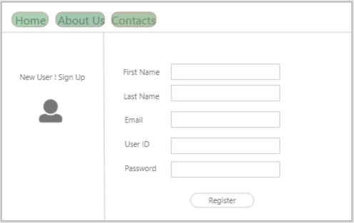
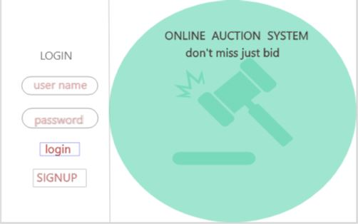
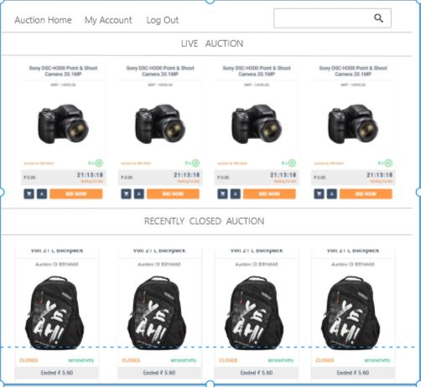
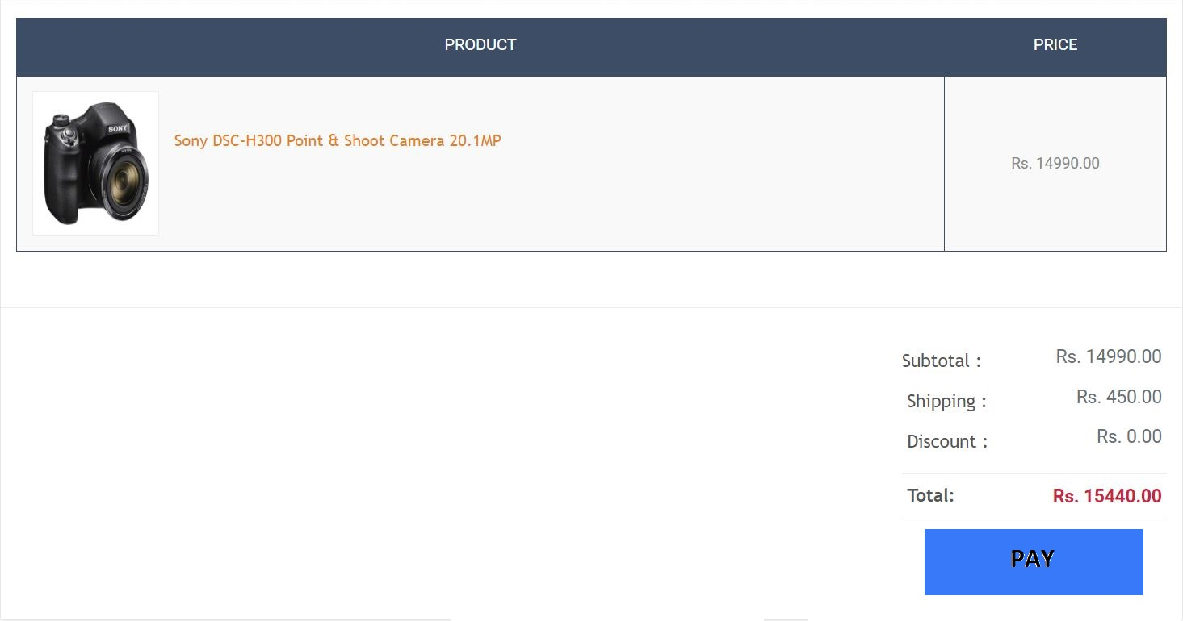
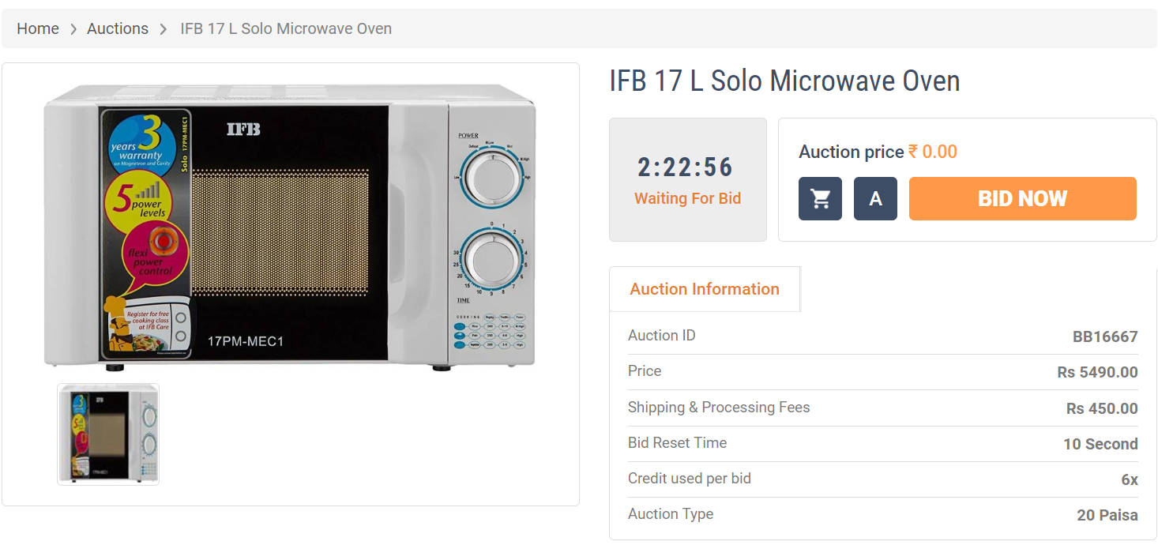
BASIC PROCESSES INVOLVED
HOME
MY CART

Slide 10
Google Firebase:
Firebase is platform which allow to build web and mobile applications without server side programming language.
You can store users data on its real-time database which sync data among users data in no time.
Firebase is a google product which offers so many useful features. Like
Real time database
Firebase Authentication
Firebase Storage
Firebase Hosting

Slide 11
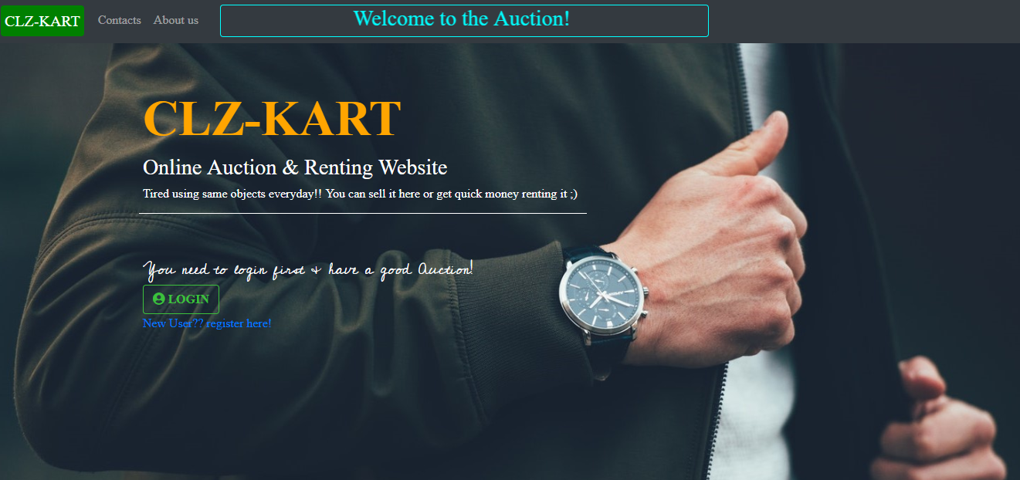
1.Home Page
This is the Landing page of our website for every user. It contains website name and basic info of our website. Then there is Login button. User needs to login first if he wants to be the part of the auction. If he is not a user yet, then there is a link to signup page with name ‘New user??register here!’ where he can register.

Slide 12
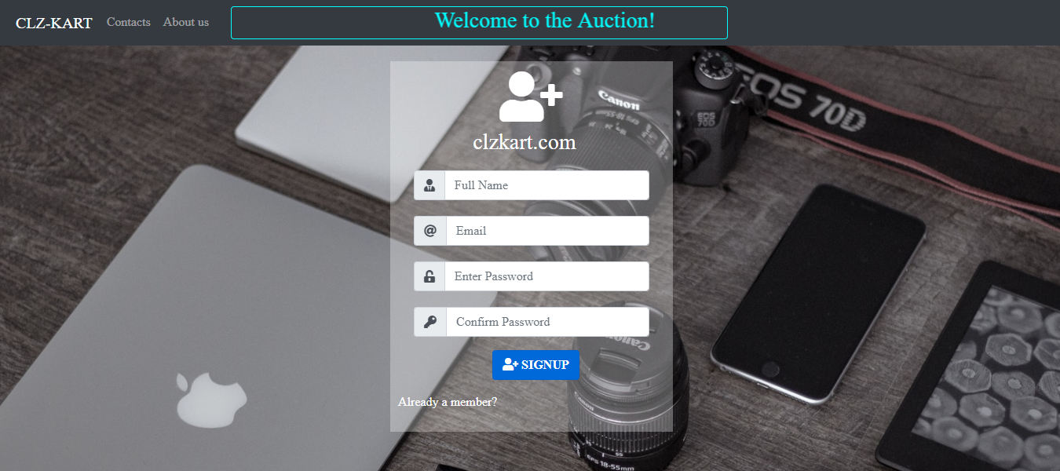
2. Signup page
This is the signup page for our website. If a user don’t have a account then he can register here . To register
a user needs to enter his full name , enter his valid email id, enter a password for the website then confirm
the password by re-entering it. Then there is a signup button to signup. Other options which this website have
is a link naming ‘Already a member?’ where he can click to redirect to login page if he is already registered.

Slide 13
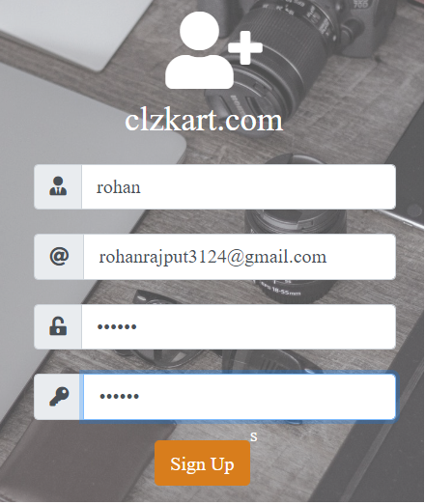
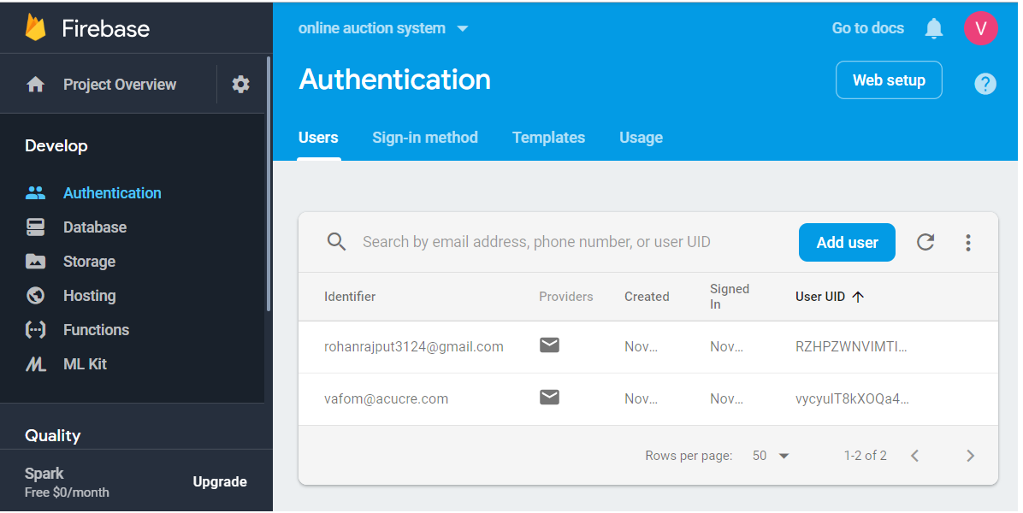
Link between Signup page and Firebase:

Slide 14
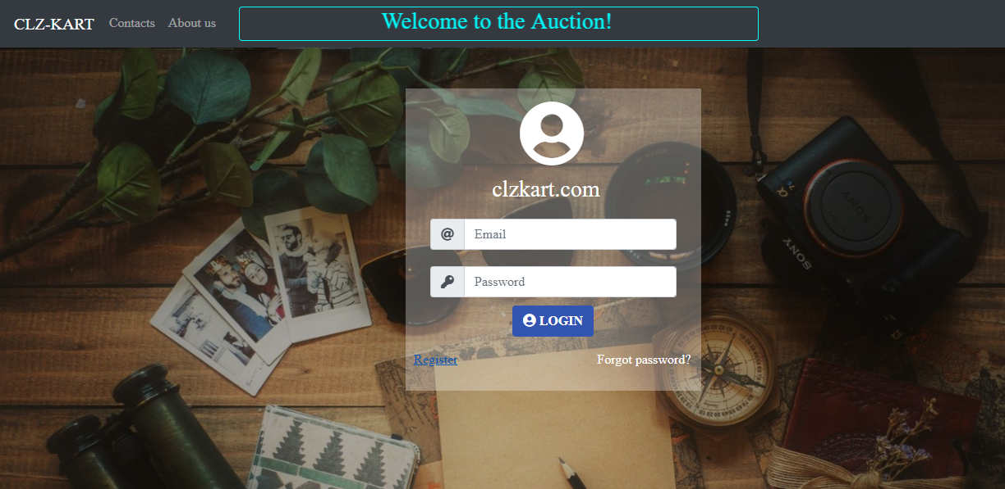
3. Login page
This is the login page for our website. User needs to enter the email and the his password to login into the
Website. Then there is login button to login. Apart from that there are two others options:
Register : Click here if user don’t have a account and register on the website.
Forgot password: If user forgets the password, then click on this link to make a new password by sending
a link on registered email.

Slide 15
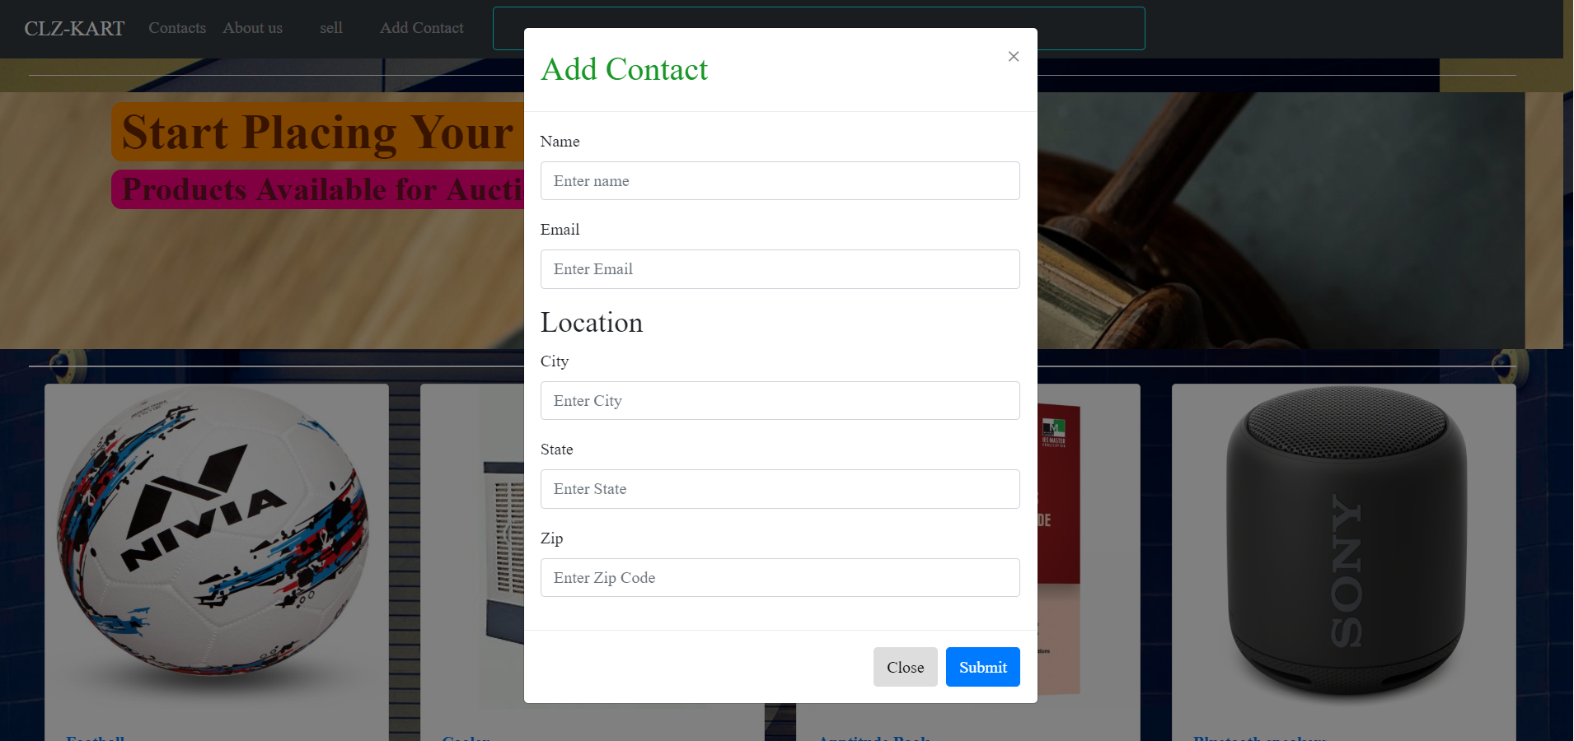
Link between Homepage and Firebase database:

Slide 16
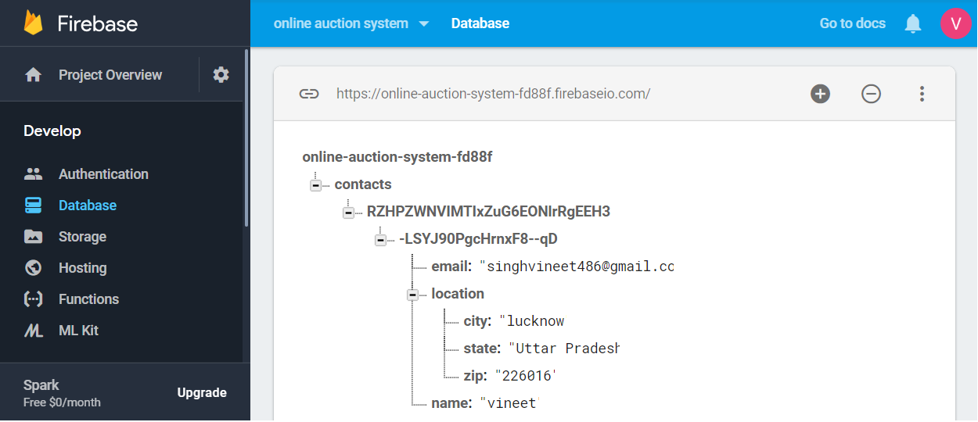
Firebase database:

Slide 17
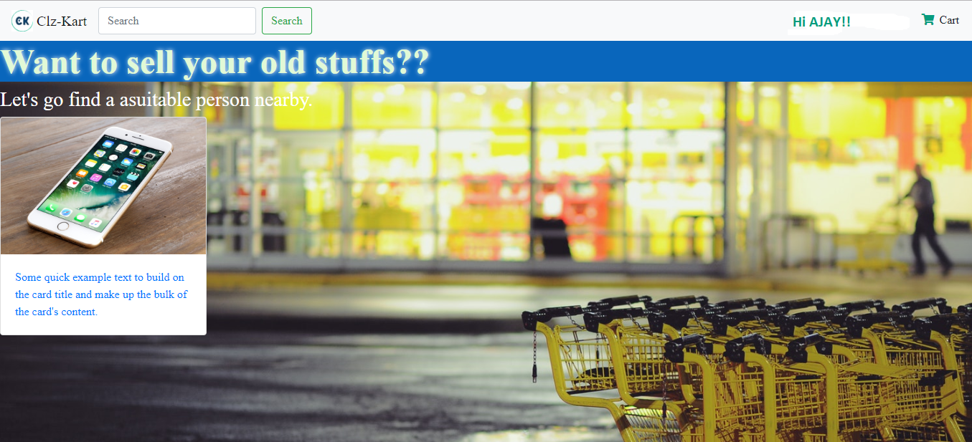
4. (Sample)Main page
This page contains search bar to search for a specific item in the webpage. This shows name of logined user
and cart option to view the products on which user is currently bidding.
Then there is an iPhone on sale with a quick description about it.

Slide 18
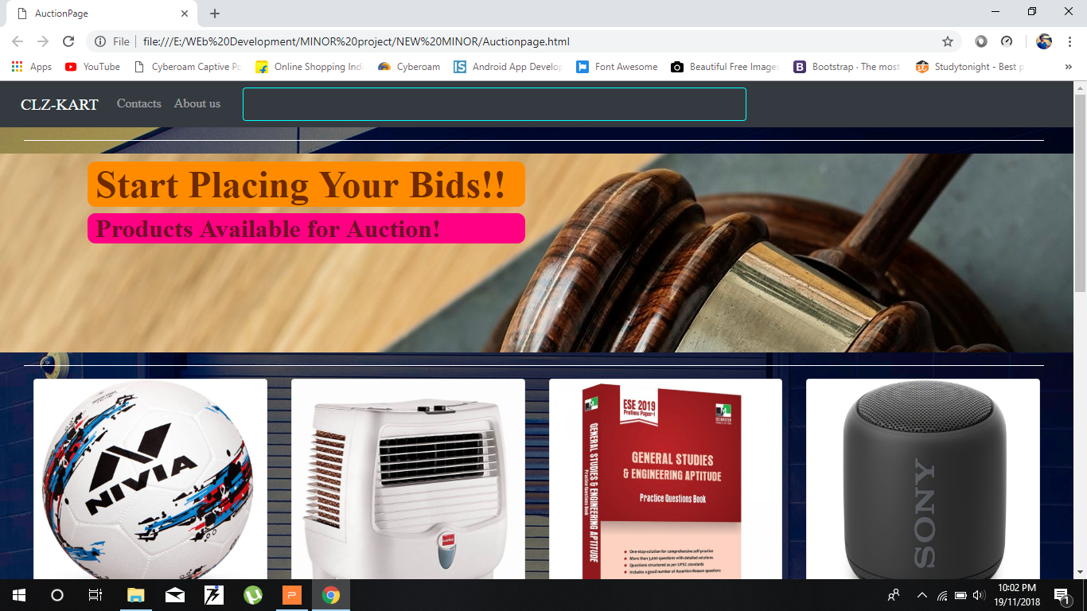
AUCTION PAGE
This is our new auction page where all the biddings for the products are done!!

Slide 19
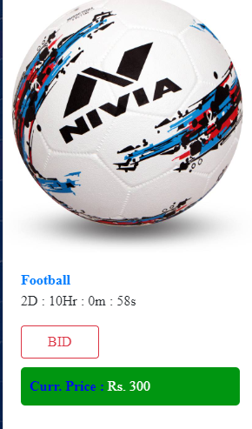
Countdown time
This is count down timer to show the total time available for bidding .
this has been done using javascript.
the customer have to bid before the end of time to buy the product.
the customer who bids the last before the time ends, wins the auction.
winner of the auction get the mail/message of account no./paytm no. of the seller to pay the price.

Slide 20
JAVA SCRIPT
JavaScript is a lightweight, interpreted programming language.
Designed for creating network-centric applications.
Complementary to and integrated with Java.
Complementary to and integrated with HTML.
Open and cross-platform.

Slide 21
Advantages of JavaScript :
Less server interaction.
Immediate feedback to the visitors.
Limitations of JavaScript :
Client-side JavaScript does not allow the reading or writing of files. This has been kept for security reason.
JavaScript cannot be used for networking applications because there is no such support
available.

Slide 22
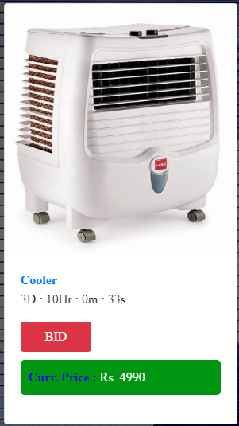
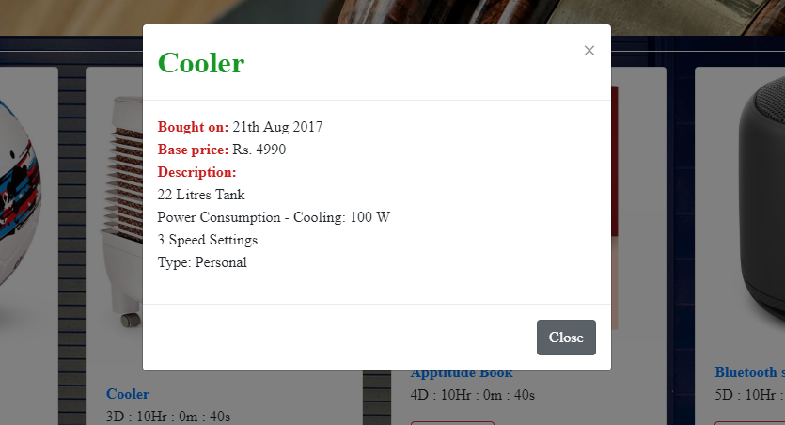
Product information:
Clicking on the product name gives the information about the product in the form of a popup.
This has been done using modals which use jquery.

Slide 23
What is jQuery?
jQuery is a lightweight, "write less, do more", JavaScript library.
jQuery takes a lot of common tasks that require many lines of JavaScript code to accomplish, and wraps them into methods that you can call with a single line of code.
The jQuery library contains the following features:
HTML/DOM manipulation
CSS manipulation
HTML event methods

Slide 24
Bidding system
This is the bidding system.
current price of the product is Rs. 4990.
when we click on the Bid button then we get a prompt message showing the next price which we have to pay after confirming.
we get the option to either select yes or no.
the logic behind the system is that it increases the price by 2%.
We use DOM manupulation for this.

Slide 25
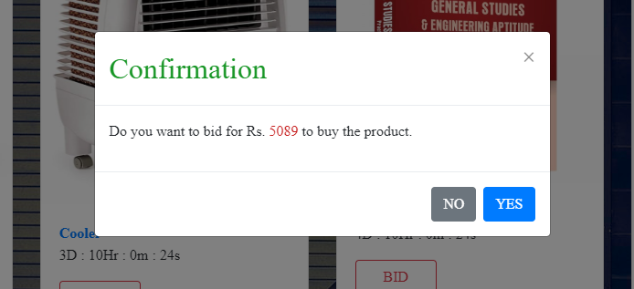
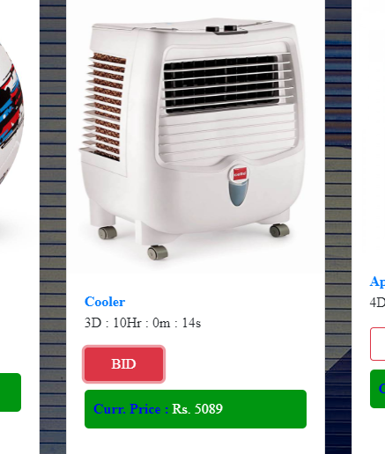
The prompt message
The new price of the product is Rs. 5089.
Now the next person will have to bid higher than 5089 to get the product and win auction.

